Slide 1

Theory of computation
By-Chandana MN
Rupa Sravya
Assigned by-Prof. Anoop Kumar Srivastava​

Slide 2
Equivalence of DFAs and NFAs

Slide 3
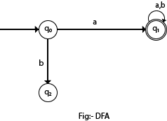
DFA
DFA refers to deterministic finite automata. Deterministic refers to the uniqueness of the computation. The finite automata are called deterministic finite automata if the machine is read an input string one symbol at a time.

Slide 4
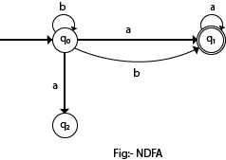
NFA
NFA stands for non-deterministic finite automata. The finite automata are called NFA when there exist many paths for specific input from the current state to the next state.

Slide 5
Conversion from NFA to DFA
M = (Q, ∑, δ, q0, F) is an NFA which accepts the language L(M).
Equivalent DFA denoted by M' = (Q', ∑', q0', δ', F')
such that L(M) = L(M').
Q: finite set of states
∑: finite set of the input symbol
q0: initial state
F: final state
δ: Transition function

Slide 6
Steps for converting NFA to DFA:
Step-01:
Let Q’ be a new set of states of the DFA. Q’ is null in the starting.
Let T’ be a new transition table of the DFA.
Step-02:
Add start state of the NFA to Q’.
Add transitions of the start state to the transition table T’.
If start state makes transition to multiple states for some input alphabet, then treat those multiple states as a single state in the DFA.
In NFA, if the transition of start state over some input alphabet is null,
then perform the transition of start state over that input alphabet to a dead state in the DFA.

Slide 7
cont
Step-03:
If any new state is present in the transition table T’,
Add the new state in Q’.
Add transitions of that state in the transition table T’.
Step-04:
Keep repeating Step-03 until no new state is present in the transition table T’.
Finally, the transition table T’ so obtained is the complete transition table of the required DFA.

Slide 8
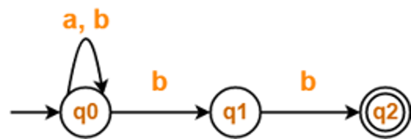
Example1
Convert the given NFA to DFA.​

Slide 9
Step1: For the given transition diagram we will first construct the transition table.
State / Alphabet | a | b
→q0 | q0 | q0, q1
q1 | – | *q2
*q2 | – | –

Slide 10
State / Alphabet | a | b
→q0 | q0 | {q0, q1}
Now we will obtain δ' transition for state q0.

Slide 11
State / Alphabet | a | b
→q0 | q0 | {q0, q1}
{q0, q1} | q0 | {q0, q1, q2}
{q0, q1, q2} | q0 | {q0, q1, q2}

Slide 12
State / Alphabet | a | b
→q0 | q0 | {q0, q1}
{q0, q1} | q0 | *{q0, q1, q2}
*{q0, q1, q2} | q0 | *{q0, q1, q2}

Slide 13
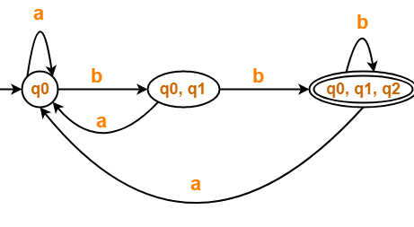
Deterministic Finite Automata (DFA)

Slide 14
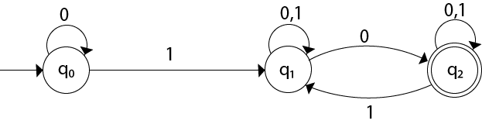
Example2
Convert the given NFA to DFA.

Slide 15
Step1: For the given transition diagram we will first construct the transition table.
State | 0 | 1
→q0 | q0 | q1
q1 | {q1, q2} | q1
*q2 | q2 | {q1, q2}

Slide 16
cont
Now we will obtain δ' transition for state q0.
δ'([q0], 0) = [q0]
δ'([q0], 1) = [q1]
The δ' transition for state q1 is obtained as:
δ'([q1], 0) = [q1, q2]
δ'([q1], 1) = [q1]
The δ' transition for state q2 is obtained as:
δ'([q2], 0) = [q2]
δ'([q2], 1) = [q1, q2]
Now we will obtain δ' transition on [q1, q2].
δ'([q1, q2], 0) = δ(q1, 0) ∪ δ(q2, 0)
= {q1, q2} ∪ {q2}
= [q1, q2]
δ'([q1, q2], 1) = δ(q1, 1) ∪ δ(q2, 1)
= {q1} ∪ {q1, q2}
= {q1, q2}
= [q1, q2]

Slide 17
The state [q1, q2] is the final state as well because it contains a final state q2. The transition table for the constructed DFA:
State | 0 | 1
→[q0] | [q0] | [q1]
[q1] | [q1, q2] | [q1]
*[q2] | [q2] | [q1, q2]
*[q1, q2] | [q1, q2] | [q1, q2]

Slide 18
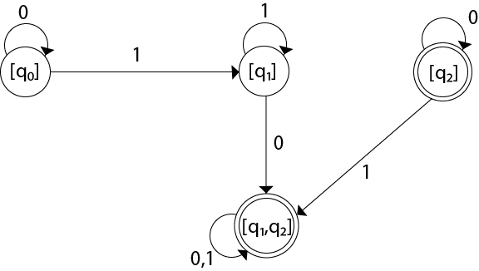
The Transition diagram:

Slide 19


